Slide 1


Plant Disease Detection System for Sustainable Agriculture
Name: VUSKAMALLA VYSHNAVI
AICTE Student ID:
STU67dc275a0abcf1742481242

Slide 2

Learning Objectives
CNN in Plant Disease Detection:
CNNs are used to detect plant diseases by analyzing leaf images. They automatically extract features like spots, edges, and color changes through multiple layers, then classify the plant’s health based on these features.
Classification Approach:
Images are normalized and resized before being fed into a CNN. The softmax layer at the end outputs the predicted disease class, like Powdery Mildew or Rust, based on the extracted features.
Deep Learning Exploration (38 Classes):
Deep learning models classify plant diseases into 38 categories. For instance, ResNet50 is used for diagnosing tomato leaf diseases like early blight, and a custom CNN model detects apple leaf diseases like apple scab.
Metrics Used :
Accuracy, Precision, Recall, F1-Score, Confusion Matrix.
Real-World Applications:
Deep learning models like ResNet50 and custom CNNs help detect plant diseases such as early blight in tomatoes and apple scab in apples, aiding crop management.
GOAL
Source :
www.freepik.com/

Slide 3
Tools and Technology used
Programming Language:
Python
Python is a popular choice for machine learning and data science because of its ease of use and powerful libraries.
Frameworks:
TensorFlow & Keras
TensorFlow: TensorFlow is an open-source framework used for developing and training neural networks in deep learning..
Keras: Keras is a high-level API built on TensorFlow that streamlines the process of creating and experimenting with models.
Development Environment:
Google Colab is a cloud-based Jupyter notebook platform that offers free GPU access, supports collaborative coding, and seamlessly integrates with Google Drive.
DataSet:
https://drive.google.com/file/d/12OS3a0bLn1zDnhqv5KRRH_BfFml6gCVX/view
I obtained the plant disease detection dataset from Kaggle, which provides a comprehensive collection of images for training and testing machine learning models.

Slide 4
Methodology
Data Collection :
Dataset with 38 plant disease classes from Kaggle.
Data Preprocessing :
Implemented 2D convolutional layers for feature extraction.
Flattened the features to feed into fully connected (dense) layers.
Used Early Stopping, Model Checkpoint, and Learning Rate scheduling to enhance model training.
Model Training:
Developed a plant disease detection system aimed at promoting sustainable agriculture, using supervised learning with labeled images of plants for training.
Evaluation & Test Cases:
Metrics used: The model's performance was evaluated using metrics like Loss, Accuracy, Precision, and Recall. It was tested on both validation and test datasets to assess its generalization. Cross-validation and confusion matrices were also used to prevent overfitting and analyze classification results.

Slide 5
Problem Statement:
Plant diseases are a major threat to global agriculture, leading to reduced crop yield and quality, and threatening food security. Early detection of plant diseases is essential to minimize damage, but traditional diagnostic methods are often slow, labor-intensive, and prone to human error. Farmers typically rely on visual inspection, which can be subjective and inaccurate, especially in remote or large-scale farming operations. As a result, many diseases go undetected until they have already spread, making it more difficult and costly to control them.
The lack of real-time, efficient tools for disease identification leaves farmers at a disadvantage, leading to delayed intervention, increased use of chemical pesticides, and greater crop loss. There is a clear need for a more effective solution that can rapidly and accurately identify plant diseases from leaf images. The goal is to create an automated system that uses deep learning techniques, such as Convolutional Neural Networks (CNNs), to detect and classify plant diseases with high precision. Such a system would empower farmers to take timely action, reduce their reliance on harmful chemicals, and promote sustainable agricultural practices. By improving disease management, this solution could enhance global food security, reduce agricultural waste, and contribute to a healthier, more sustainable farming ecosystem.

Slide 6
Solution:
AI-Powered Detection: Leveraged Convolutional Neural Networks (CNNs) to identify 38 different plant diseases from leaf images, providing a robust and efficient detection system.
High Precision: The model achieved an impressive validation accuracy of 96.4%, ensuring consistent and precise disease classification.
Time Efficiency: By automating detection, the model significantly cuts down the time spent on manual diagnosis, offering faster results.
Preventive Action: Early disease identification allows for proactive measures, reducing disease spread and limiting crop damage.
Eco-Friendly Farming: Facilitates sustainable agriculture by promoting the use of fewer chemicals and more efficient resource management.
Innovation in Agriculture: Showcases the power of AI in transforming farming practices, setting the stage for advanced, technology-driven solutions.

Slide 7
Solution :
Source Code :
https://github.com/vuskamallavyshnavi03/AICTE/blob/main/v.vyshnavi/Plant_Disease_Detection_System%202.ipynb
Given the computational limitations on Google Colab, we restricted the model training to 5 epochs to avoid runtime issues and ensure smooth performance. Colab's GPU access comes with constraints on both time and memory, which can hinder longer, more resource-intensive training processes. Despite limiting the training to 5 epochs, the model demonstrated impressive accuracy and effectiveness, showcasing its potential. Running the same process on a CPU would drastically slow down the training, turning what could take minutes into hours, making it less feasible for rapid experimentation.

Slide 8
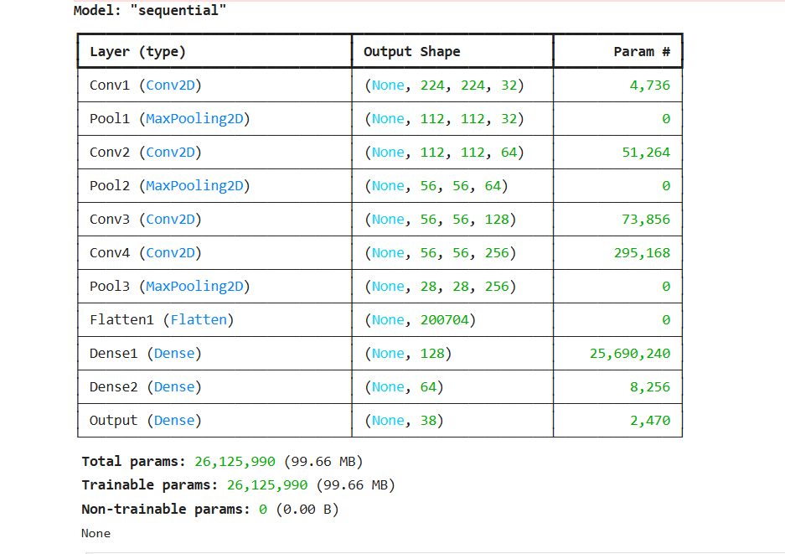
Screenshot of Output:

Slide 9
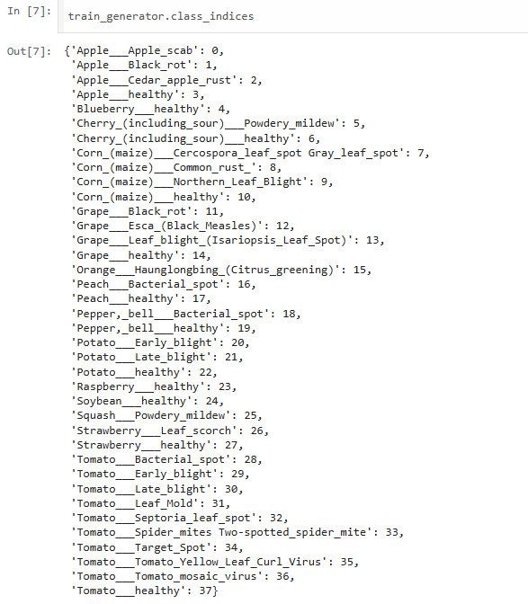

Slide 10
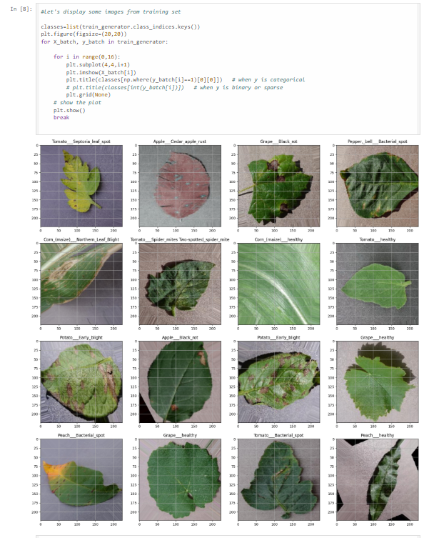

Slide 11
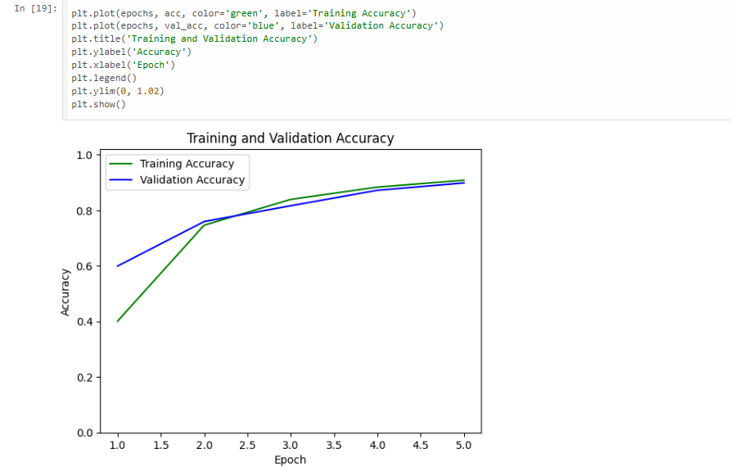

Slide 12
Conclusion:
The Plant Disease Detection System for Sustainable Agriculture offers a powerful solution to the challenges faced by farmers in managing crop health. By utilizing deep learning technologies, the system accurately detects and classifies plant diseases at an early stage, enabling prompt intervention and minimizing crop losses. This approach supports sustainable agriculture by reducing the need for harmful chemical treatments and optimizing resource use. With its potential to improve crop yield, reduce environmental impact, and enhance food security, the system represents a significant step toward the future of smart farming, combining technology with sustainable practices for a healthier planet.
Future Scope:
The future scope of the Plant Disease Detection System lies in expanding its capabilities to detect a wider variety of crops and diseases, enhancing its accuracy with larger datasets. Integrating the system with IoT devices and predictive analytics can enable real-time monitoring and proactive disease management.

